Slide 1
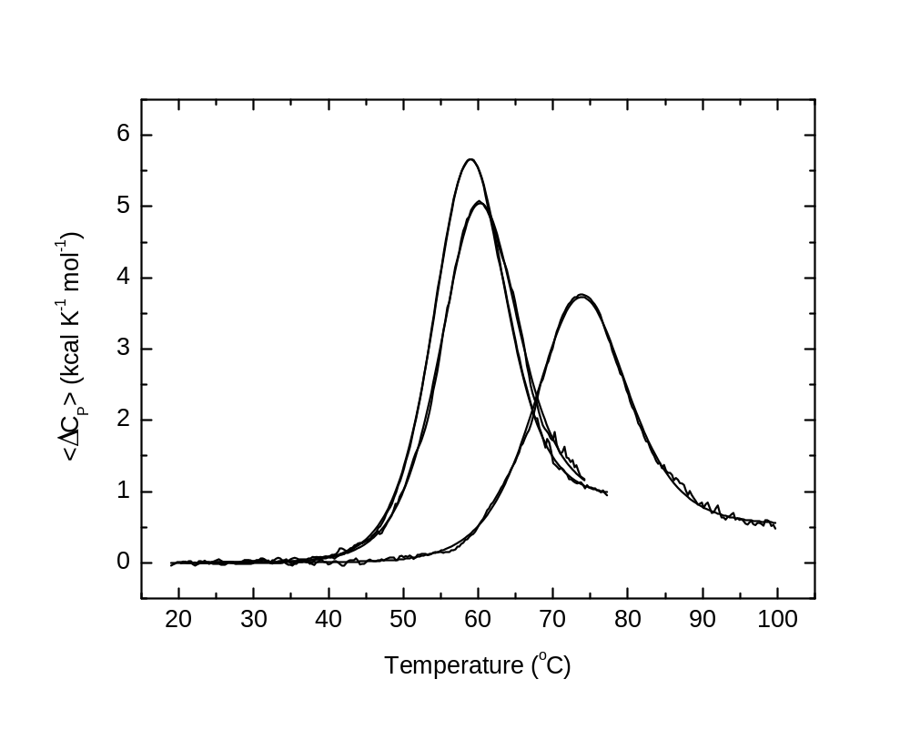
 | T_{m} (ºC) | ΔH(T_{m}) (kcal mol⁻¹) | ΔC_{P} (kcal K⁻¹ mol⁻¹)
SH3 WT | 58.2 | 67 | 0.9
SH3 Mutant | 73.0 | 57 | 0.5
SH3 Mutant + TCEP | 59.4 | 63 | 0.9

Slide 2
